Slide 1
MSc Research Project Allocation
Oli Bills
ofb@ecs.soton.ac.uk

Slide 2
Today
About the project
Background to the process
The timelines involved
How we help you find a supervisor
How allocation works
What happens next

Slide 3
What is the project?
Your chance to undertake a substantial project in your area
1) Develop original ideas and solve complex problems in new or unfamiliar environments, based on advanced knowledge of the principles and methodologies of your discipline
2) Integrate knowledge and handle complexity in your area, formulating sound judgements with incomplete or limited data
3) Communicate your conclusions and the underpinning knowledge and rationale clearly and unambiguously to specialist and non-specialist audiences
4) Develop your independent learning skills as required for continued professional development

Slide 4
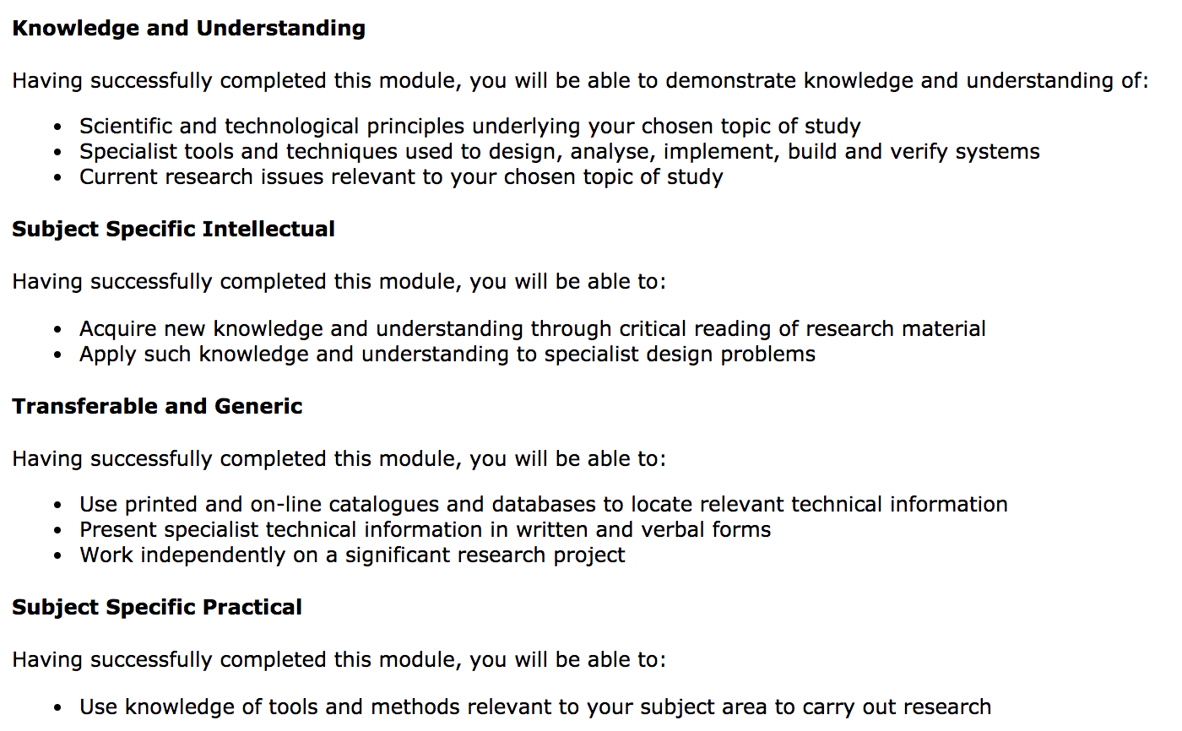
What is the project?

Slide 5
Expectations of the project
Individual research project
Show advanced knowledge/understanding
Apply this knowledge with confidence to solve problems, preferably in a creative/original way
Cite relevant research/standards/white papers
Critically evaluate the literature/state of the art
Reflect on your own achievements

Slide 6
The Allocation Process
Academics enter potential projects and topics into a list
Some are more specific
Some are very general
But all are up for discussion – they are just potential ideas
You look through the list and pick at least 8 options of interest using the Choices system
The system will do it’s best to match everyone with a supervisor of their choice
It’s not first come first serve
The options you pick help us find the right supervisor for you, doing a topic you want to do

Slide 7
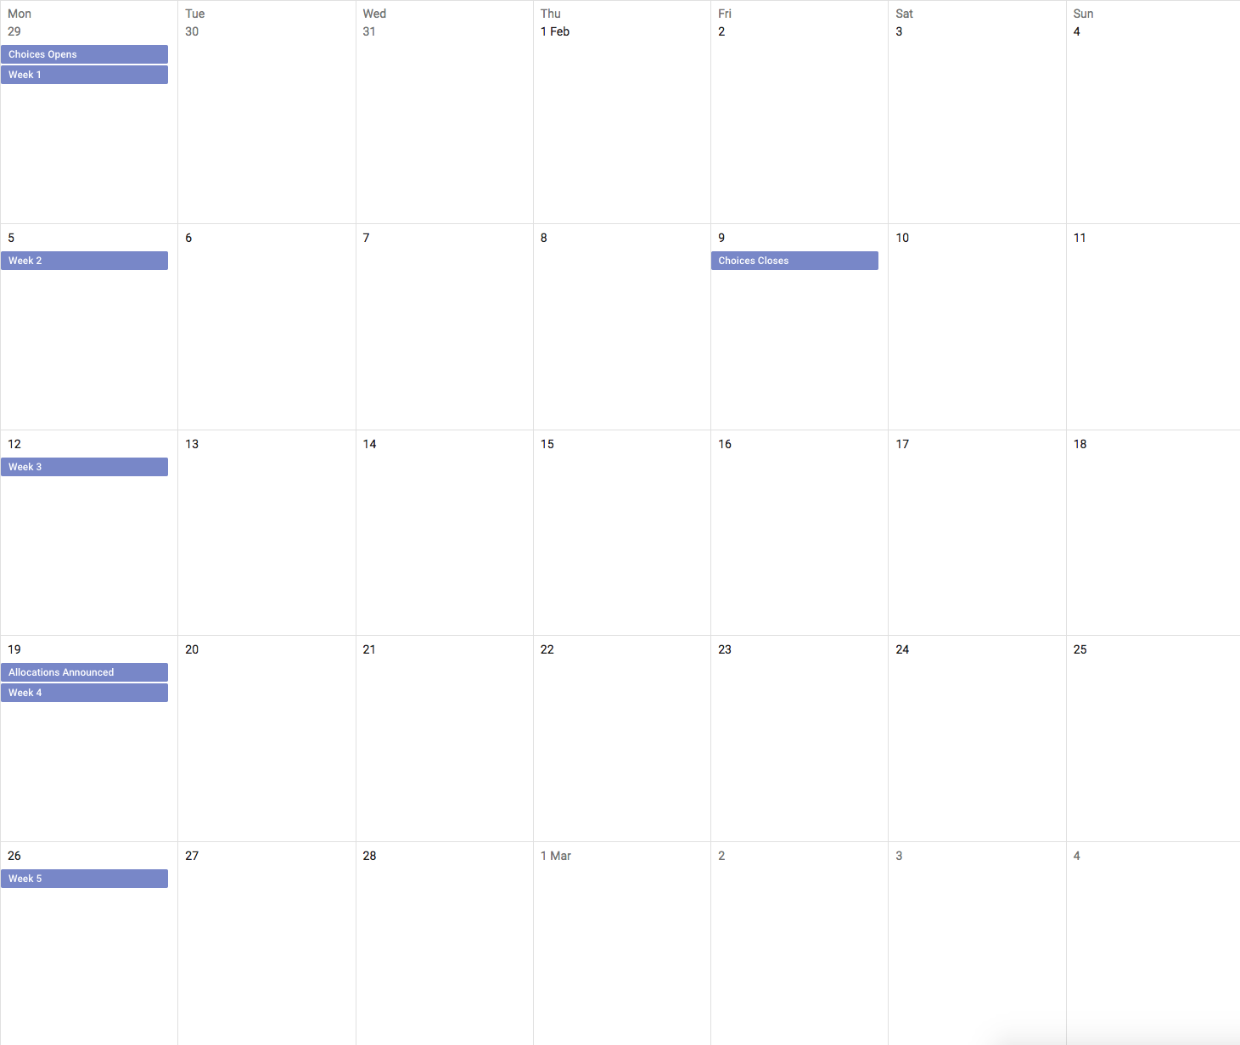
January - February
29th
5th
9th
12th
19th
26th

Slide 8
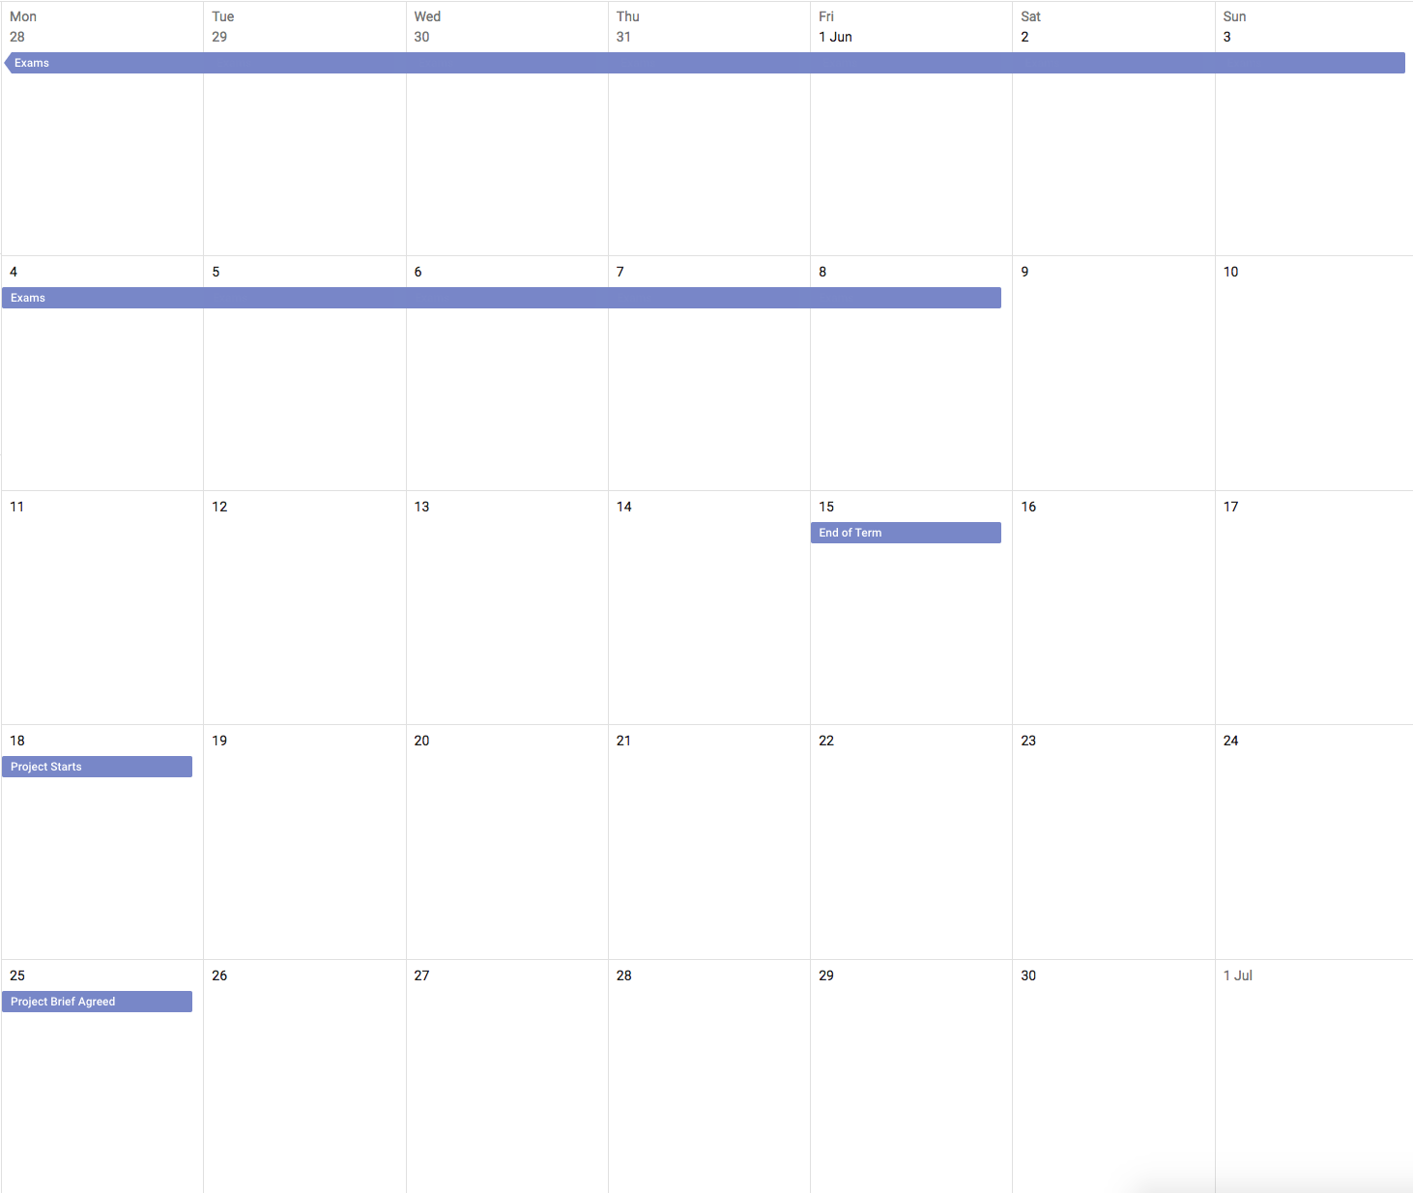

May - June
28th
4th
11th
18th
25th

Slide 9
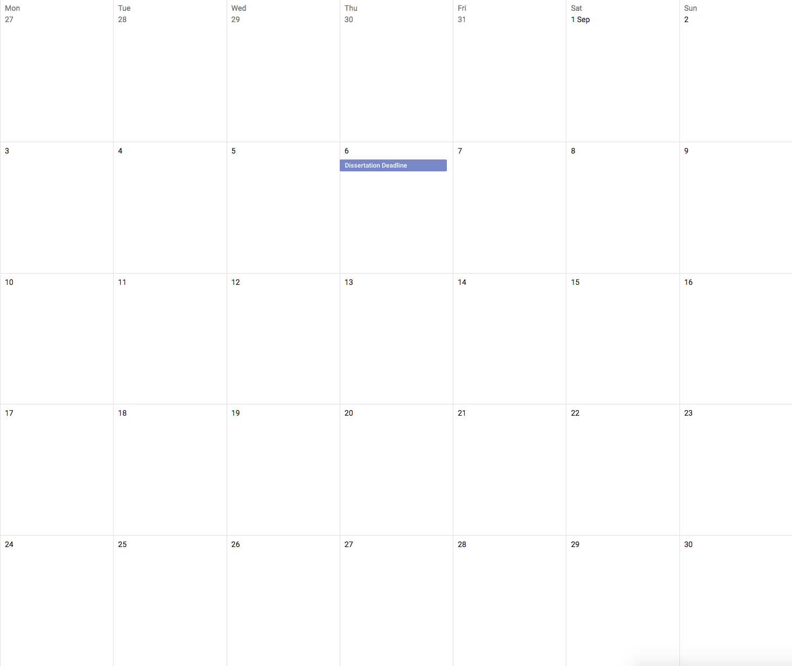

September
27th
3rd
6th
10th
17th
24th

Slide 10
What you need to do
Step 1: Think about what you want to do
Step 2: Explore the potential project areas
Step 3: Choose the areas you are interested in
Step 4: Wait to be allocated
Step 5: Agree on a project area

Slide 11
Step 1: Think
Think about what kind of project you’d like to do
Think about what topics interest you most

Slide 12
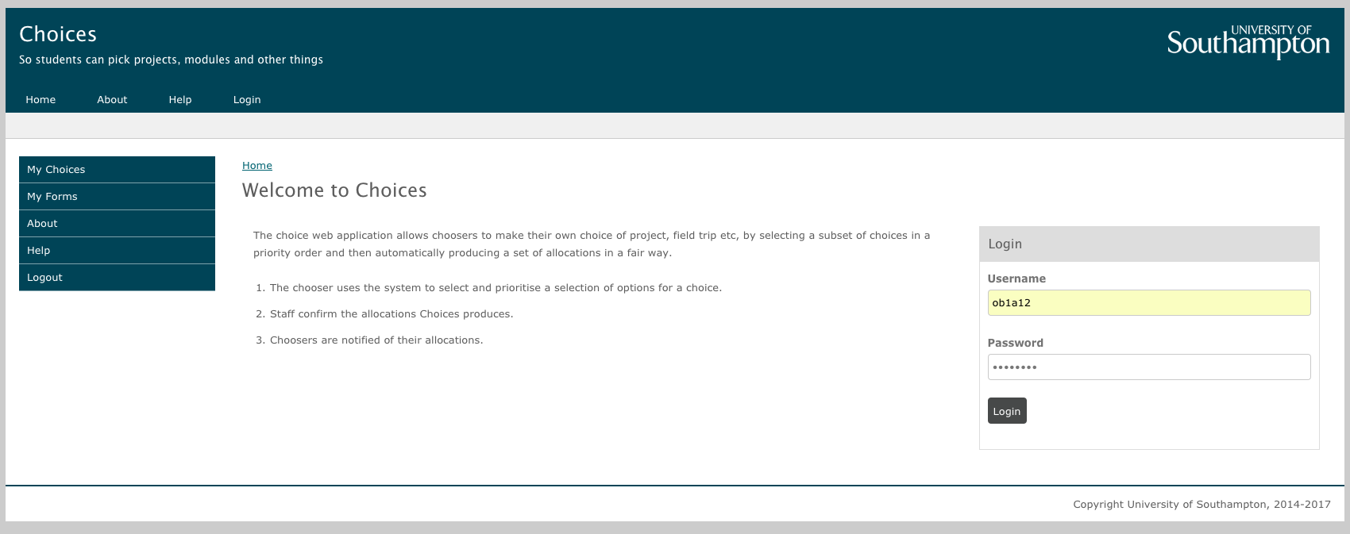
Step 2: Explore

Slide 13
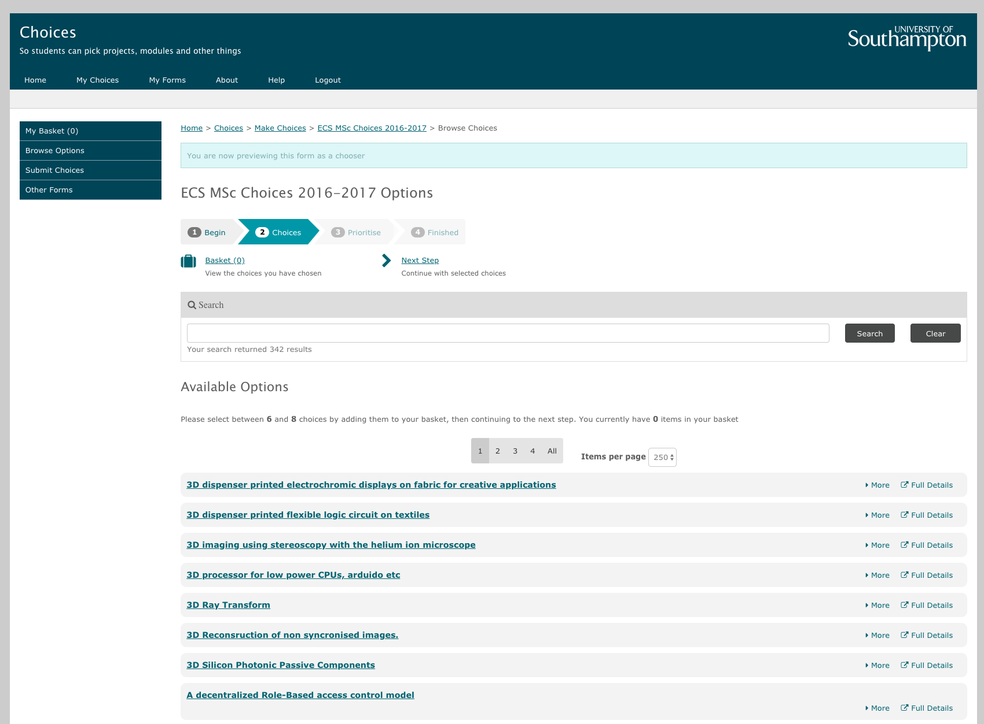
Step 2: Explore

Slide 14
Step 2: Explore
Remember, these are just example or potential projects or topics
These are not final project definitions
There is a lot of flexibility!
Once you meet with your supervisor, you can discuss ideas and decide together what you’d like to do
Which may or may not have anything to do with the options you selected!

Slide 15
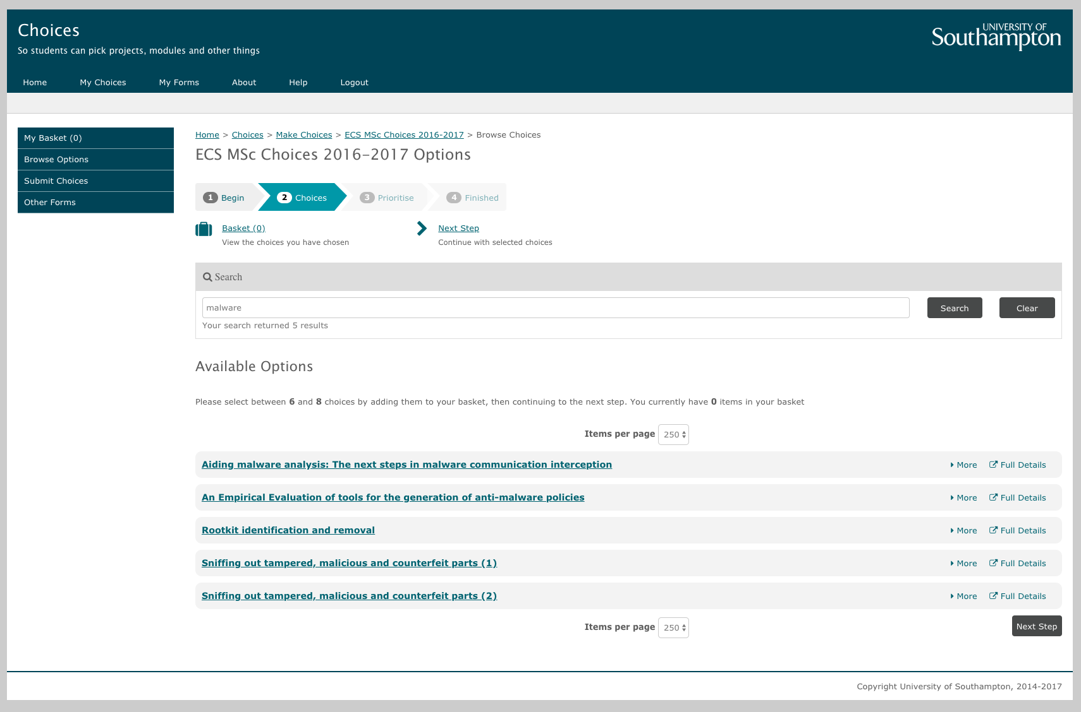
Step 2: Explore

Slide 16
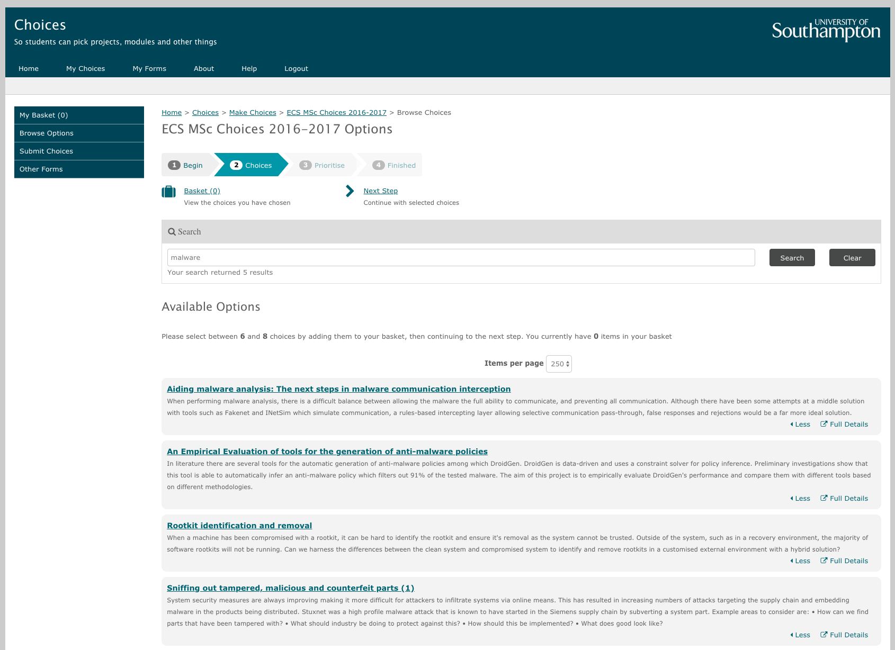
Step 2: Explore

Slide 17
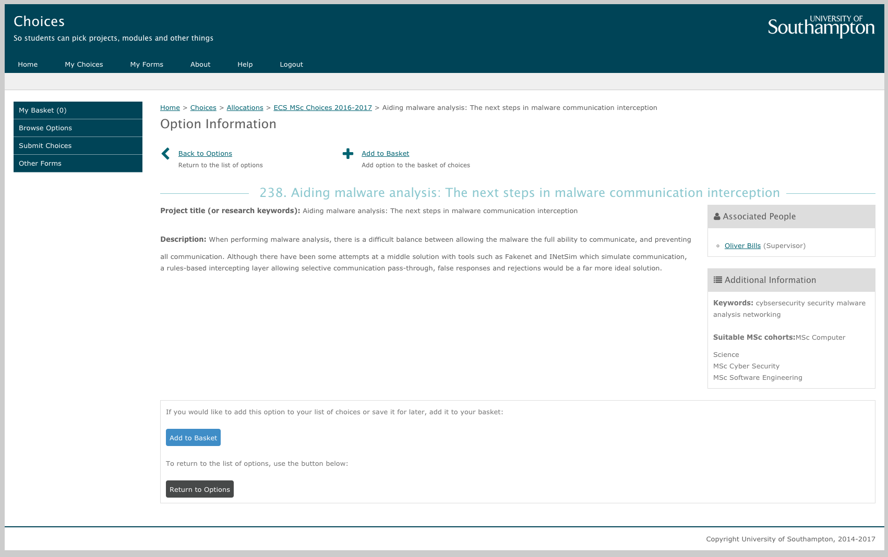
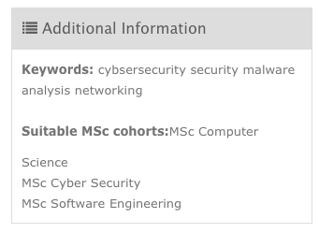
Step 2: Explore

Slide 18
Your Programme Leader
While you are exploring…
Your programme leader will explain…
What types of projects are available/appropriate
Any specialist tools/techniques you may need
Any questions you may have about any options
Do you have a specific idea for a project?
Select any similar/related projects
Tell your programme leader

Slide 19


Step 3: Choose

Slide 20
Step 3: Choose
Make sure the projects that you pick are all suitable for your cohort
If there is a project you have found that you want to do but isn’t listed for your cohort, tell your programme leader

Slide 21

Step 3: Choose

Slide 22
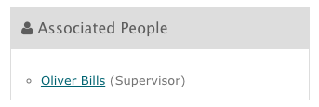
Step 3: Choose
You must pick at least 8 options
You must pick options from at least 6 different supervisors
Think carefully about a range of projects/supervisors - only considering your favourite lecturers won't work

Slide 23
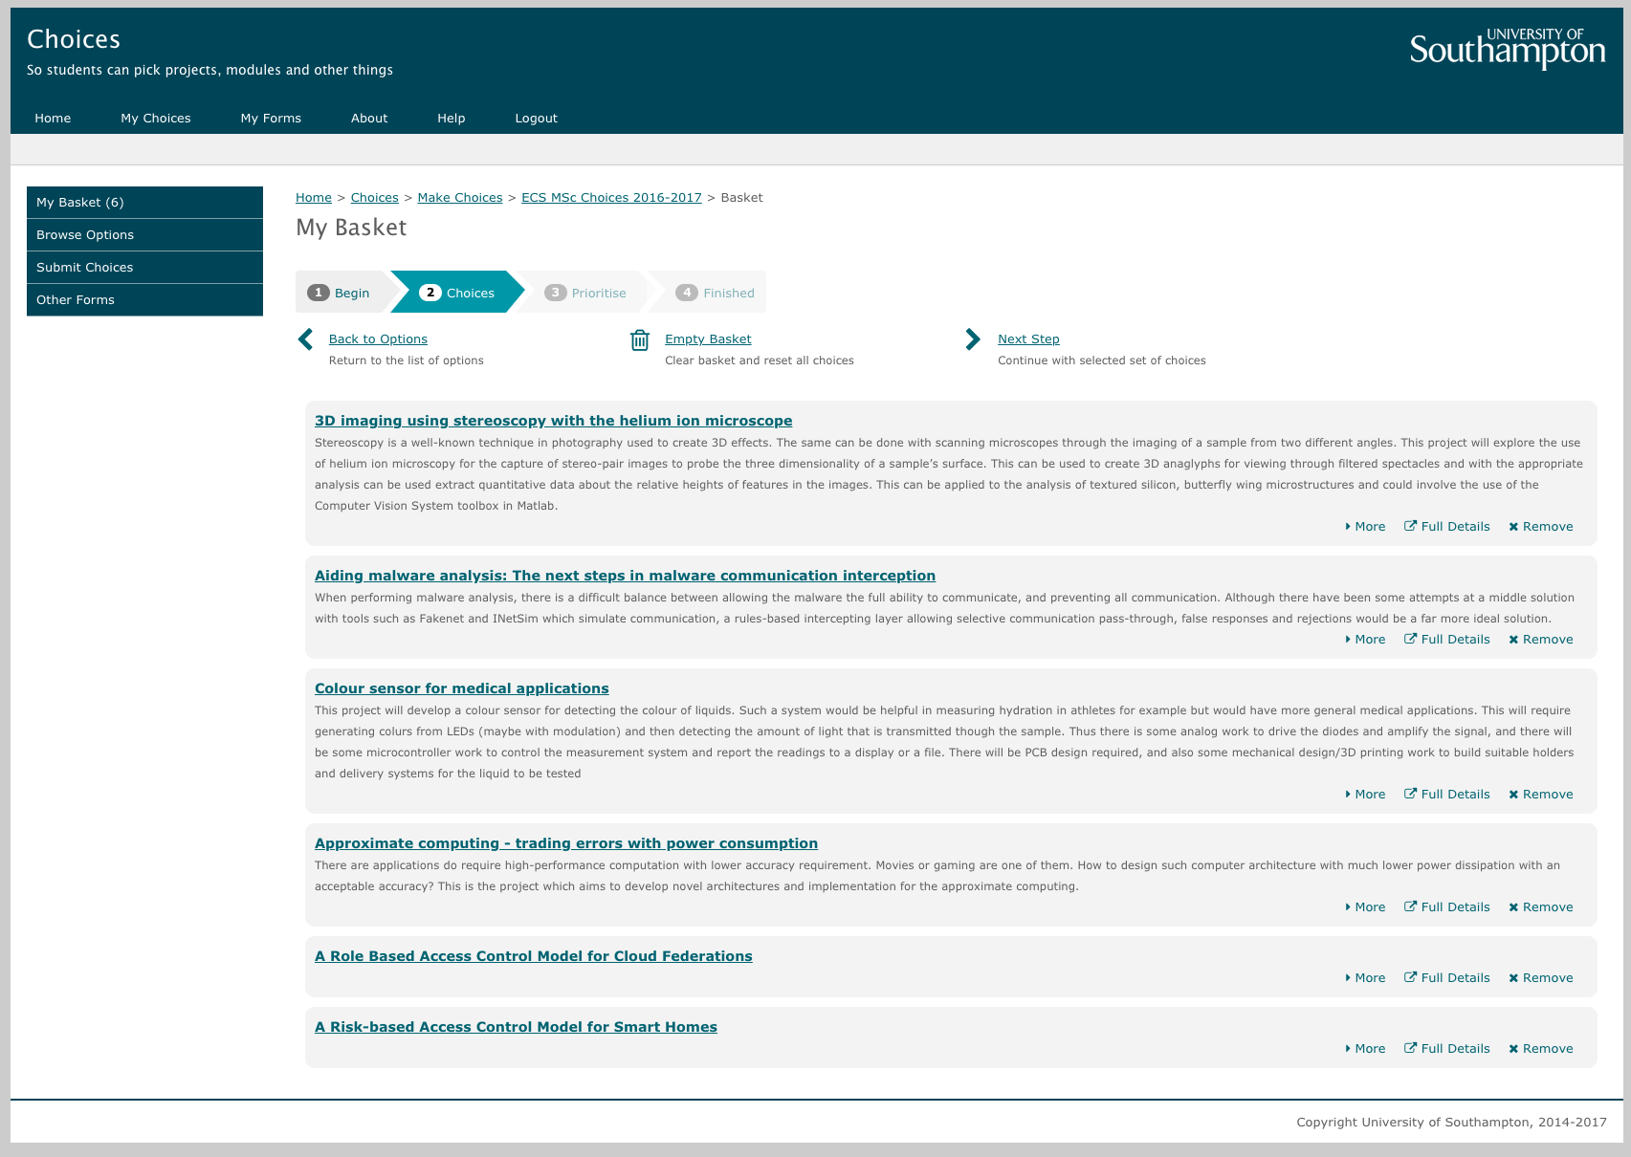
Step 3: Choose

Slide 24
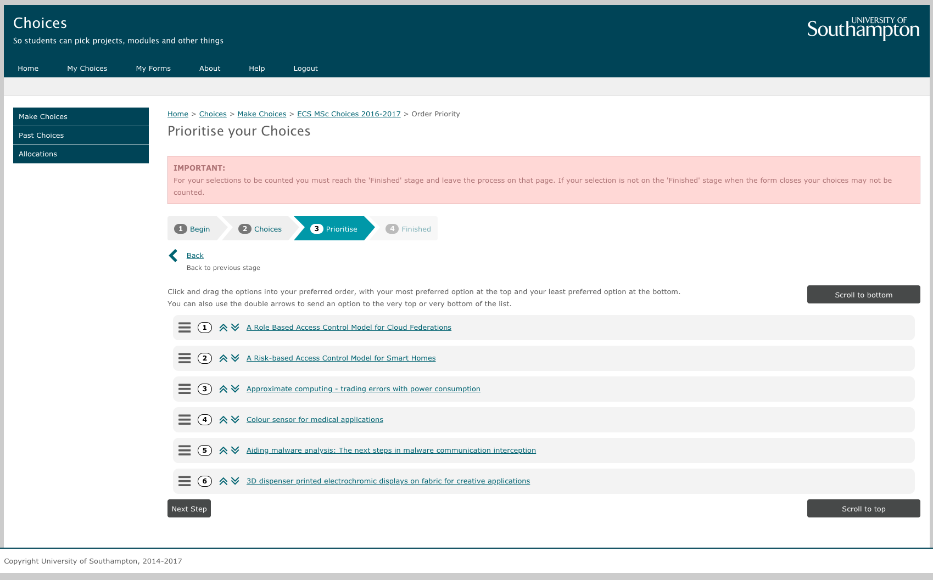
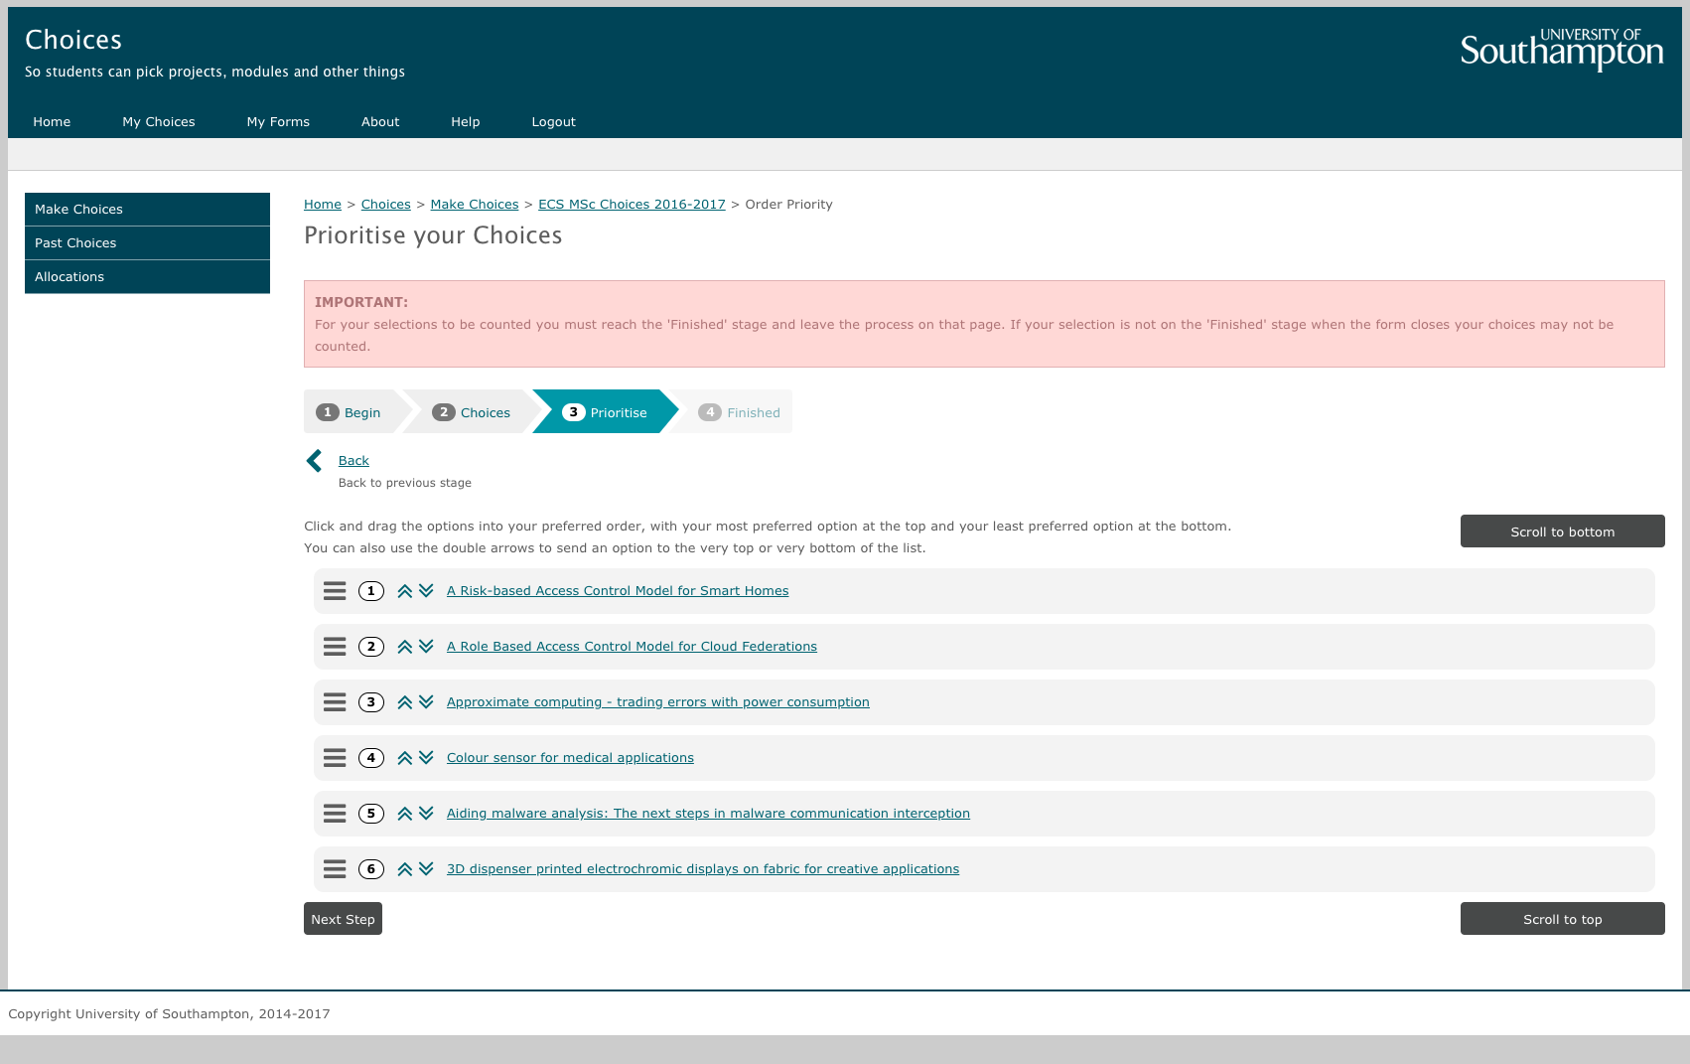
Step 3: Choose

Slide 25
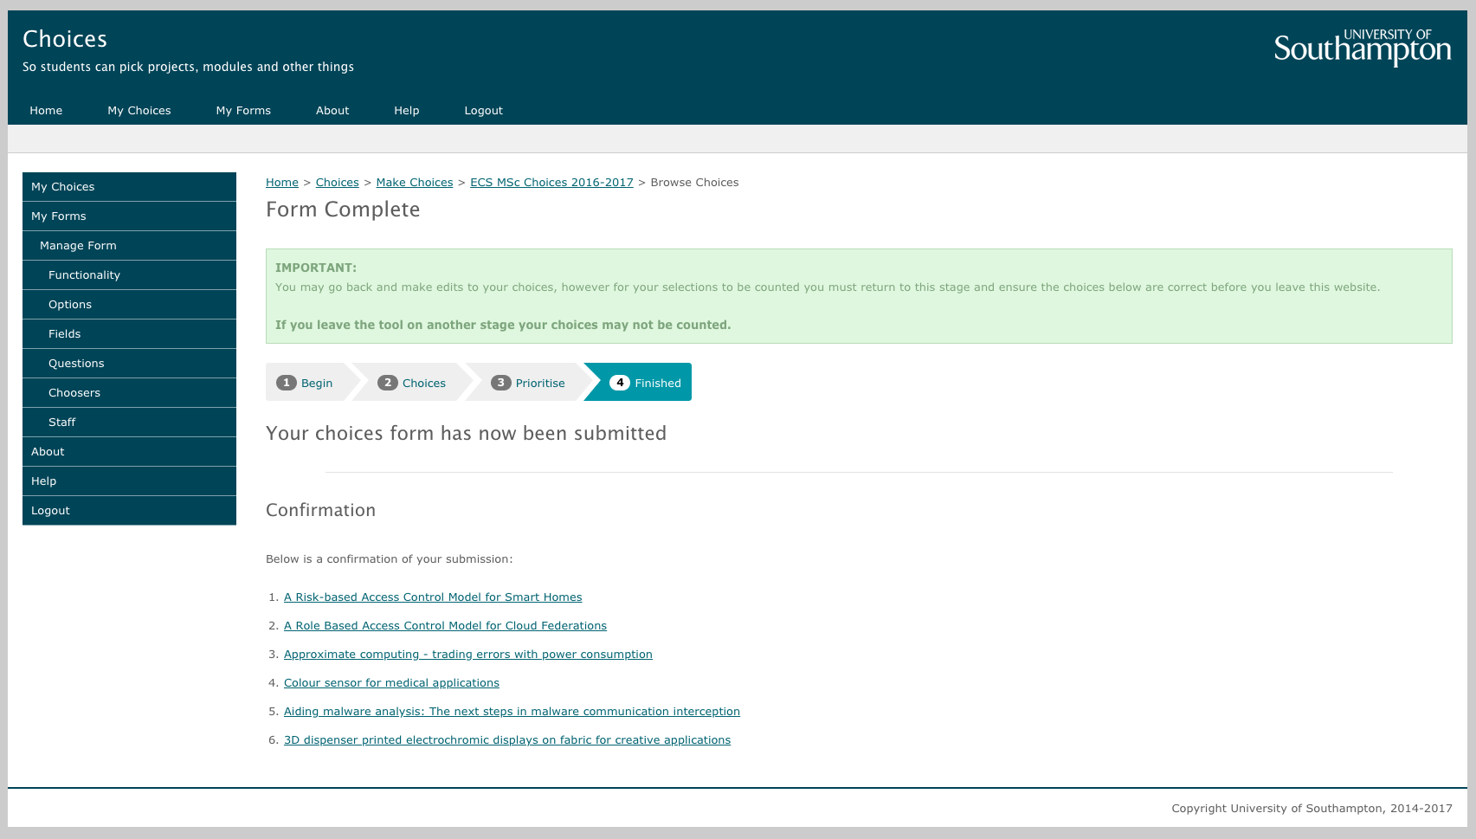
Step 3: Choose

Slide 26
Step 4: Wait
Up to the deadline, you can go back in and make changes
But if you do, make sure you get back to the confirmation screen!
After the deadline, we’ll be sorting out the allocation
The system will produce an initial allocation
Programme leaders can adjust the allocation
We’ll let you know when it’s done

Slide 27
Step 5: You’re allocated!
Now you have a supervisor!
As soon as you are allocated, you can go and meet them
Talk about potential projects and ideas
It does not have to be a project on the system
Agree on what you’d like to do
Any topic agreed by the supervisor and the student and within the scope of your MSc programme

Slide 28
What if things go wrong?
If there can be absolutely no agreement of a project between the student and supervisor
There is the option to be re-allocated
But remember, options will be limited at this stage!
So make sure you are careful with your choices!

Slide 29
What not to do!
Do not contact potential supervisors directly
Choices handles the allocation, not supervisors
It is not the supervisor’s decision
But you can discuss with your programme leader
Do not ignore the advice
You need to pick at least 6 different supervisors
If you ignore this, and that supervisor isn’t available, you’ll end up with something you have not even considered!
Do not leave it to the last minute
Think carefully about your choices
Especially choices 2-8…
There’s absolutely no guarantee you’ll get your first

Slide 30
What happens next?
This process all starts right at the start of Semester 2
Next semester, you will have a Project Preparation module
This will help you prepare for your project
Meeting your supervisor
Being happy with your project
Time management skills
Research skills
Planning your project
Questions and answers

Slide 31
And then what happens?
Then after the exams, the project formally starts!
Weekly meetings with your supervisor
You’ll be allocated a second examiner
Meet them a couple of times over the Summer
Working 9-5 on your project
Demonstration in August
Deadline in September

